Slide 1

DON BOSCO INSTITUTE OF TECHNOLOGY
DEPARTMENT OF INFORMATION SCIENCE AND ENGINEERING
INTERNSHIP PRESENTATION
ON
ONLINE WATCH SHOP
USING FULL STACK WEB DEVELOPMENT
By:
DEEPIKA M L
USN :1DB20IS043
Under the guidance of:
Mrs. Yashodara R
Asst prof, Dept. of ISE

Slide 2
ABSTRACT
Web development is the work involved in developing a web site for the internet (World Wide Web) or an intranet (a private network) web development can range from developing a simple single static page of plain text to complex web-based internet services.
An online watch shop is a virtual store that allows customers to browse, select, and purchase gadgets and items through the internet.
Online watch shopping offers many benefits over traditional brick- and-mortar stores. This report scrutinizes the dynamic realm of online watch stores specializing in the sale of different watches. It dissects the driving forces behind this burgeoning market, highlighting the consumer's escalating appetite for convenient access to premium produce

Slide 3
INTRODUCTION
Aim of the Project
Aim of an online watch shop is to provide customers with the convenience of ordering gadgets from the comfort of their own homes or workplaces and have them delivered directly to their doorsteps. Some specific goals of the project might include
Building a responsive and intuitive user interface that provides user to easily buy the items. • Integrating with a backend system to order various products real-time
Purpose of the Project
This project is aimed at developing an online watch website system which can be used in small places, and medium cities firstly and then on a large scale. It is developed to help the restaurants to simplify their daily operational and managerial tasks as well as improving the dining experience of the customers. Everything will be under the one dashboard page such as the Home page, Menu page, About Page and the Contact Page. The main advantage of this project is that it is very easy to Customize the ordering system.

Slide 4
About the Project
The proposed project is an Online Watch Shop using React JS and MongoDB.
Its role is to view the set of items by Clicking on the Order Now page. It consists of mainly to manage all the information about the different lists of categories which are available. The project is totally built at a administrative and thus only the administrator can view and see the details which are present at the watch website. It provides the facilities that the customers wanted. If the customers feel it is difficult to access the website then they can contact the administrative by using the toll number.
Objectives of the Project:
Know About the objectives.
Learn New Skills
Professionally
Get Constructive Feedback
Establish Yourself Professionally

Slide 5

COMPANY PROFILE
Corporate Name: PRINSTON SMART ENGINEERS
Main Office: Vishnuvardhan Statue Rd, Vishwa Priya Nagar, Begur, Bengaluru, Karnataka 560068
Phone: +91 9810 188 747
Contact Person: Mrs. Fraheen Farhath (Managing Director)
Email Address: Prinston.Smart@gmail.com
Year Stand Up: 2004
Company Category: IT Software/Embedded

Slide 6
TRAINING CONTENT
FRONT-END TECHNOLOGIES
HTML - Hyper Text Markup Language
Hypertext Mark-up Language (HTML) is the standard mark-up language for documents designed to be displayed in a web browser. Web browsers receive HTML documents from a web server or from local storage and render the documents into multimedia web pages.
CSS - Cascading Style Sheets
Cascading Style Sheets (CSS) is a style sheet language used for describing the presentation of a document written in a markup language such as HTML. CSS is a cornerstone technology of the World Wide Web, alongside HTML and JavaScript.CSS is designed to enable the separation of presentation and content, including layout, colours, and fonts.
React JS
React js more commonly Known as React, is a free, open-source Javascript library. It works best to build the user interfaces by combining the sections of code into the full websites. Originally it was built by facebook, Meta and the open-source community.

Slide 7
Node JS
Node JS is a open source environment for executing the JavaScript code. Node is used extensively for executing the JavaScript code. Node is used for developers to use Javascript for the client-side
BACK-END TECHNOLOGIES
Mongo DB
Mongo DB is a non-relational document database that provides support for JSON-like storage, the MongoDB database has a flexible data model that enables us to store unstructured data,and it provides full indexing support, and the replication with rich and intuitive API’s. A WS enables us to set up the infrastructure to support the MongoDB database deployments in a flexible, scalable, and cost-effective manner on the AWS Cloud. AWS also enables us to run MongoDB-compatible workloads.

Slide 8
REQUIREMENT SPECIFICATION
The system requirement and specification of our project is as follows:
Hardware Requirements
Processor: i5 Core Processor
Monitor: 1024 * 768 Resolution Color
Keyboard: QWERTY RAM: 1 GB
Motherboard: 845c Intel Motherboard
Backup Media: Floppy/pen drive/Hard disk.
Hard disk: 1 TB HDD
I/O Device: Standard input and output devices.
Software Requirements
Mongo DB Server
React JS and Node JS: Version 7.1.0
Operating system: Windows 10

Slide 9
IMPLEMENTATION
We have implemented the following functionalities in the project :-
• CLIENT Side Functionalities:
1.User must be able to Login page before the viewing of Watch Website.
2. User must be able to Order, View and navigate to the next page.
3. Coming out of website after seeing order details and contacting if necessary.
• SERVER Side Functionalities:
1. Check the localhost connection.
2. Check if the server is running at the specified address.
3. Store the details of all customers during the Login page.
4. To check if unique object id is created for different set of customers.

Slide 10
FRONT END TASKS
1. Create login page using username and password.
2. Create the Home page, Category page, About Page and Contact page.
3. Create All the necessary pages for each link and the functionalities.
4. Style all the Web pages.
CONNECTION
1. Implement the functionalities for each of the web page.
2. Use the appropriate Query for the functionalities.
3. Follow the same procedure –
- Create a Mongo DB localhost connection.
- Prepare the statement.
- Bind the parameters if required.
- Execute the statement.

Slide 11
BACK-END TASKS
1. Establish a local host connection.
2. Connect it to a host IP address.
3. Store the user registered details.
4. Create object id’s,username.

Slide 12
MONGO DB CONNECTION
Depending on the version of MongoDB compass, there are either one or two APIs for accessing the Mongo DB database.
users can choose between the deprecated database extension, mongoDB, or mongosh.
mongosh connects the Mongodb extension, leaving only database and details.
Mongosh – Mongo shell connection.
IMPORTANT MODULES
I have implemented 5 tables in my Food Website That is:it has different Modules which are used are the following:
Register Page
Home Page
Login Page
About Page
Contact Page

Slide 13
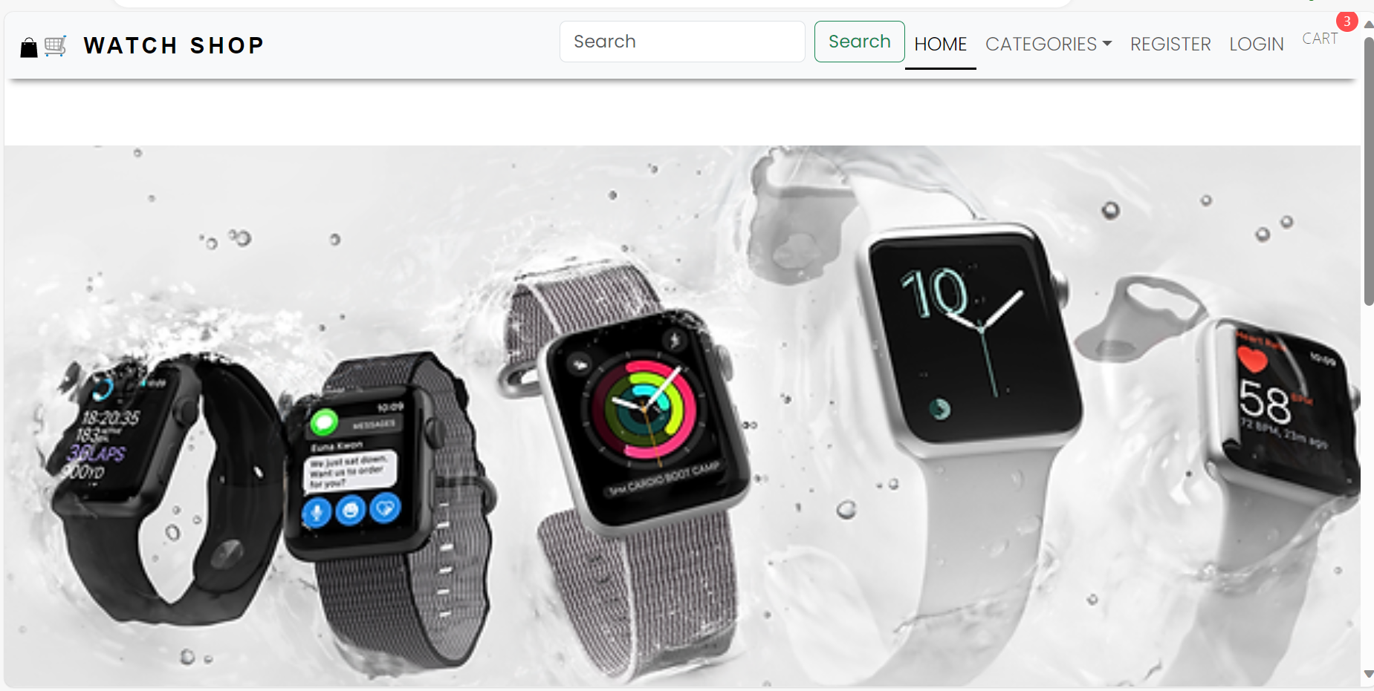
SNAPSHOTS

Slide 14

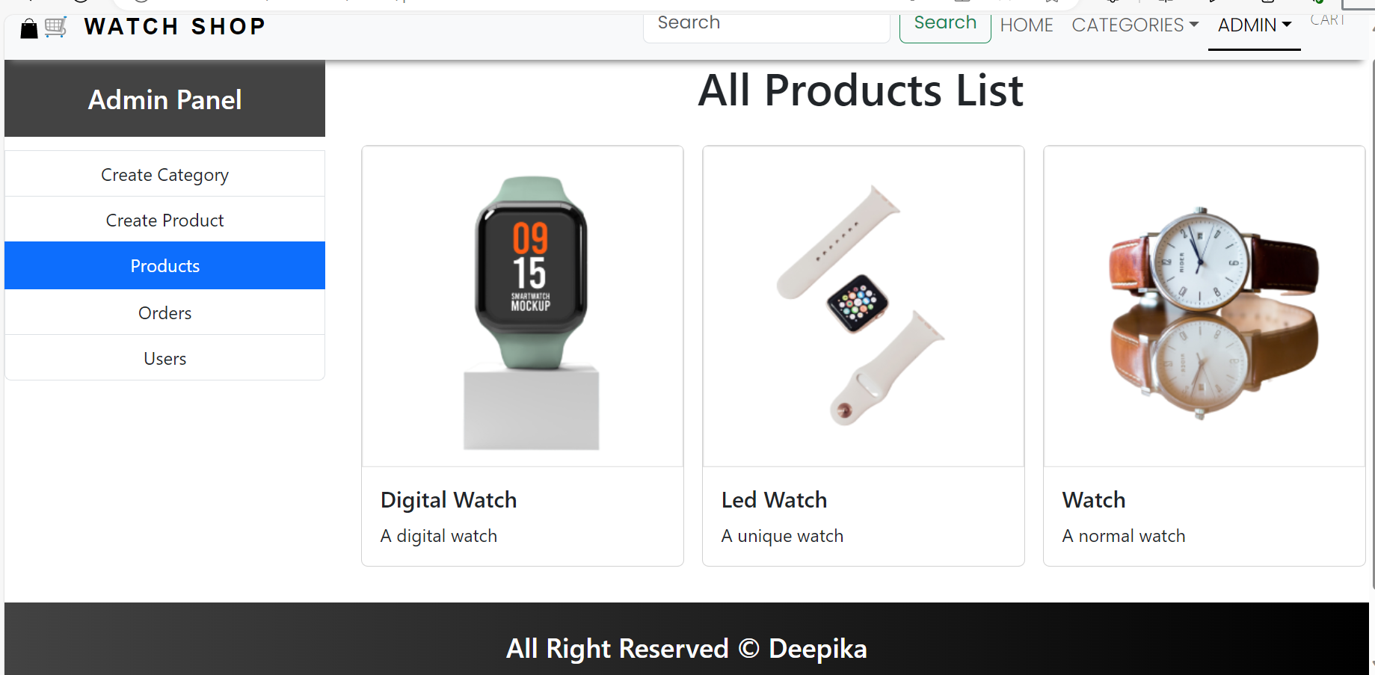

Slide 15
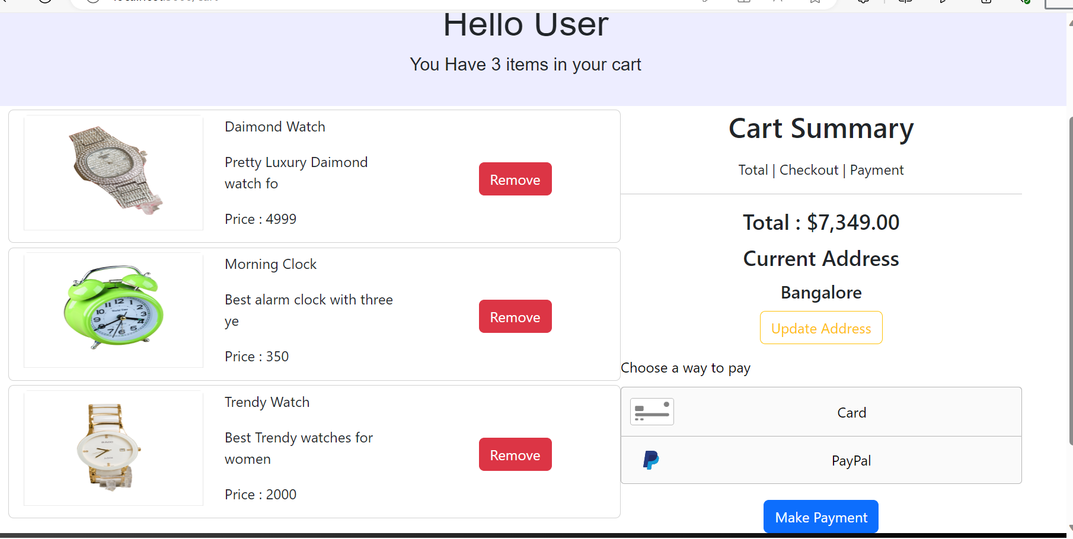

Slide 16
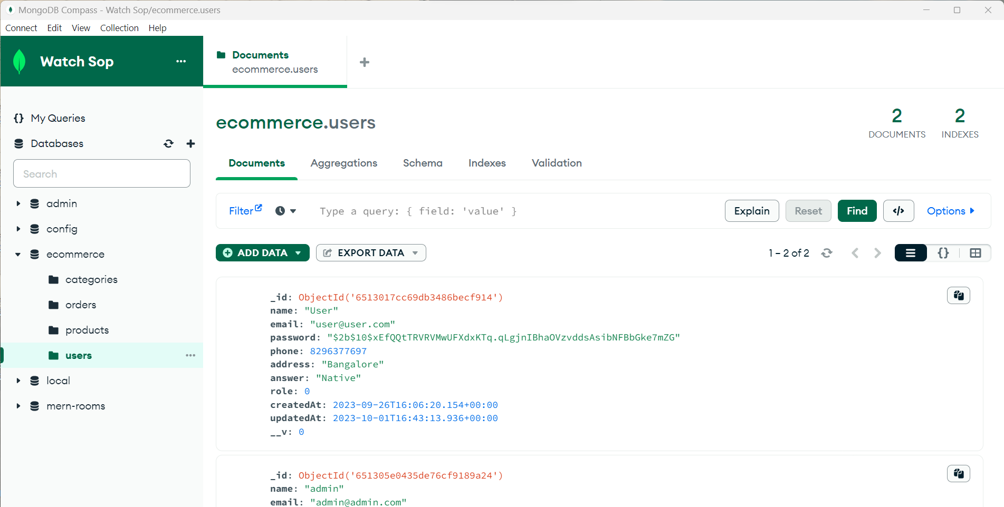

Slide 17
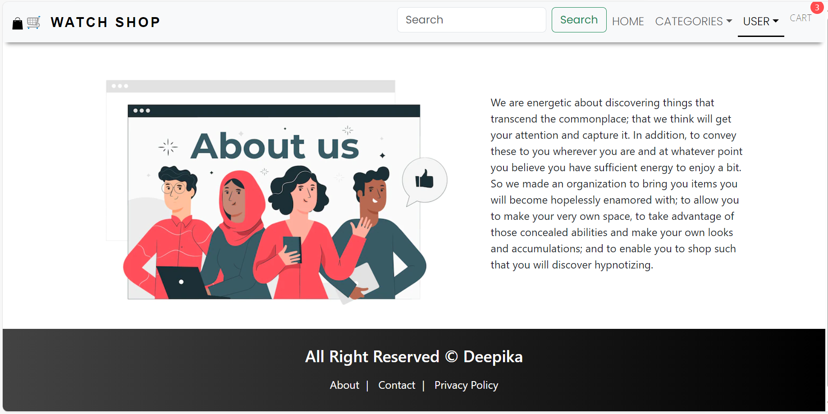

Slide 18
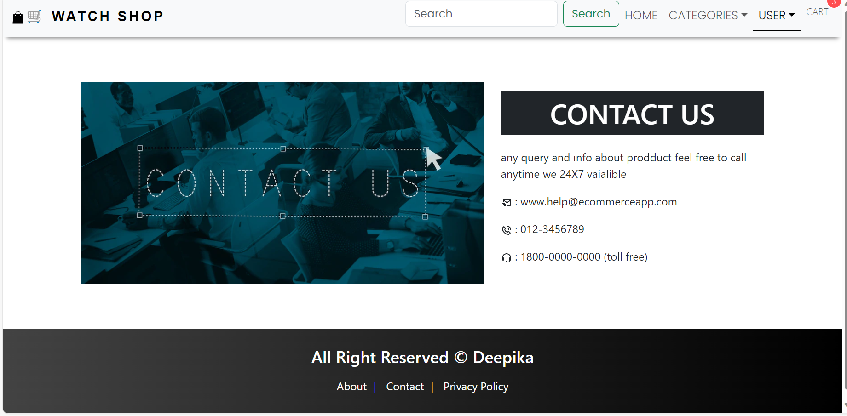

Slide 19
REFERENCES
WEBSITES:
[1] www.technifo YT.com.
[2] https://www.codecademy.com/learn/learn-php.
[3]www.tutorialspoint.com,.Available:https://www.tutorialspoint.com/system_analysis_and_design/system analysis_and_design_overview .html. [Accessed 25 04 2017].
[4]Martinig & Associates, "www.methodsandtools.com," 1995-2017. [Online]. Available: http://www.methodsandtools.com/archive/archive.php?id=113. [Accessed 28 05 2017].

